Slide 1
Vector Semantics and Embeddings
4주차 발표 – 박현아

Slide 2
Contents
1. Introduction
2. Lexical Semantics
3. Vector Semantics
4. Words and Vectors
5. Cosine for measuring similarity
6. TF-IDF
7. PMI
8. Word2vec

Slide 3
Introduction
수렴 진화(convergent evolution)
: 생물학적으로 전혀 다른 종이 비슷환 환경에 적응하여 유사한 모습을 띄는 것
분포 가설(distributional hypothesis)
: 비슷한 맥락에서 사용된 단어들이 비슷한 의미를 지니는 관계
=> vector semantics!!

Slide 4
Lexical Semantics
lemma, citation form, wordforms, word sense, polysemous
Ex) mouse/mice, sing/sang
동의어(synonym), 유사(similarity)
Ex) couch/sofa, dog/cat
word relatedness(association), semantic field, semantic frame
Ex) coffee/cup
affective meaning(connotations)

Slide 5
Vector Semantics
모르는 단어 : Ongchoi
Ongchoi is delicious sauteed with garlic.
Ongchoi is superb over rice.
...ongchoi leaves with salty sauces...
embeddings

Slide 6
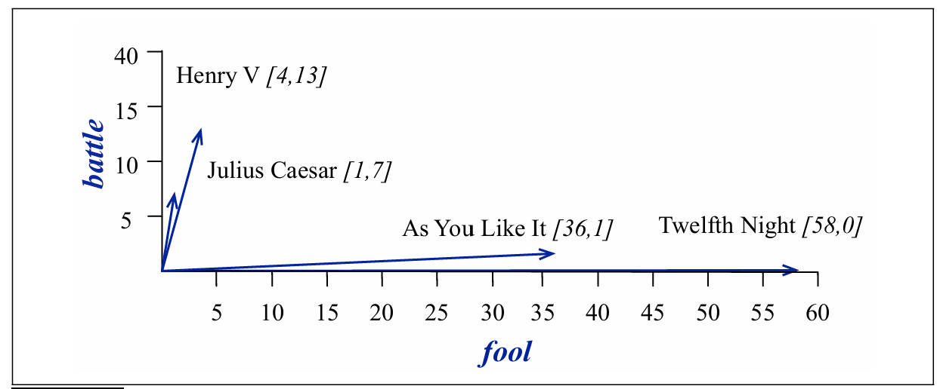
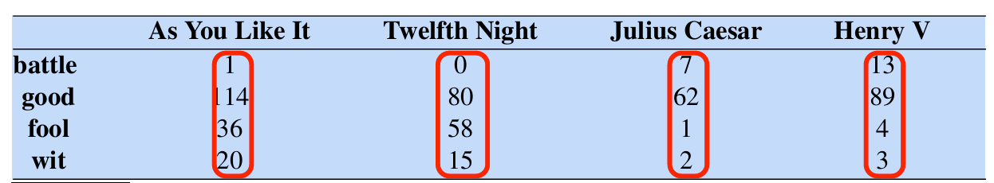
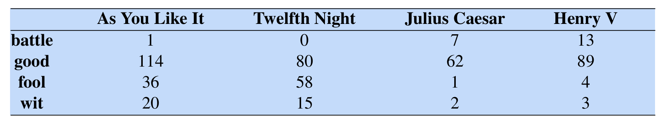
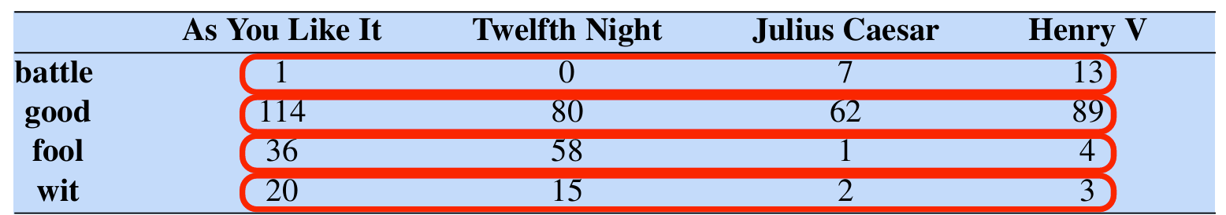
Words and Vectors
co-occurrence matrix : 문서-단어, 단어-단어
문서-단어 행렬(term-document matrix)

Slide 7
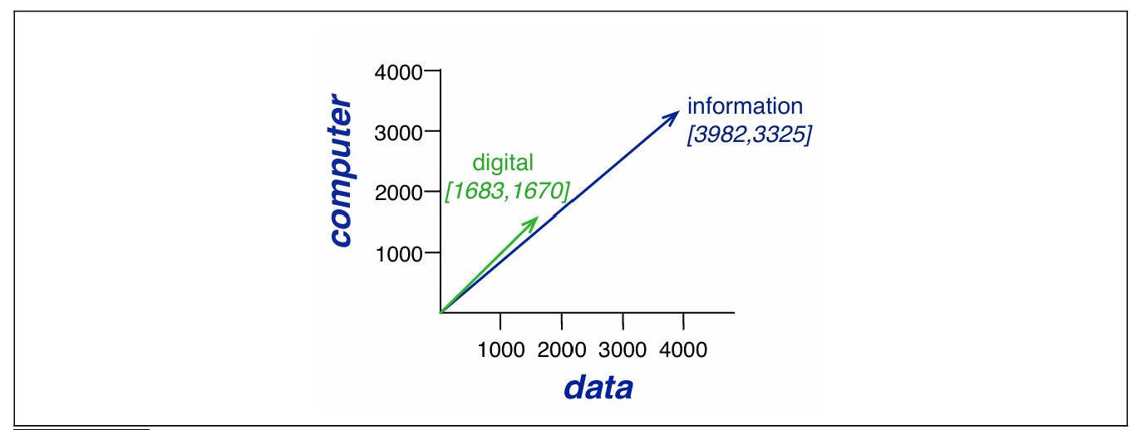
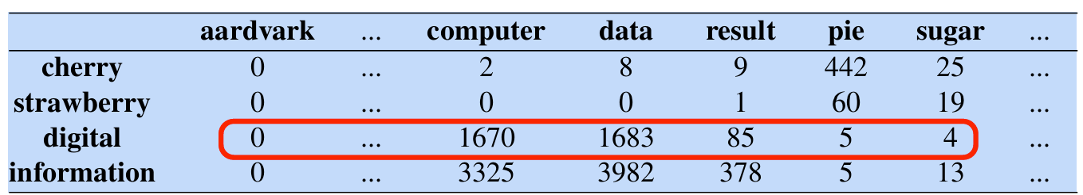
Words and Vectors
단어-단어 행렬(term-term matrix)

Slide 8
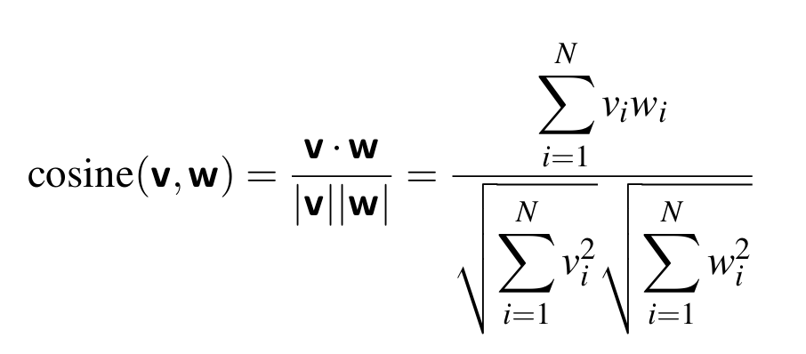
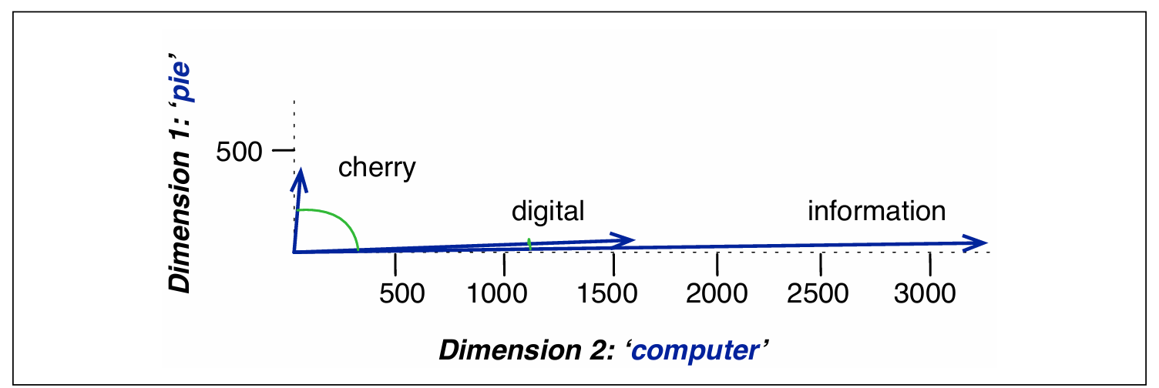
Cosine for measuring similarity

Slide 9

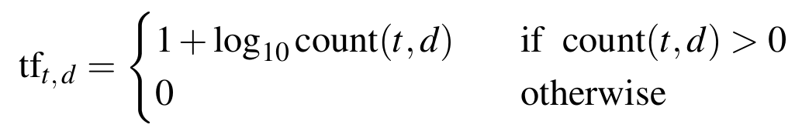
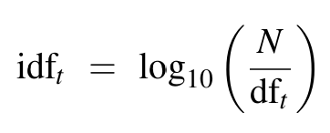

TF-IDF

Slide 10
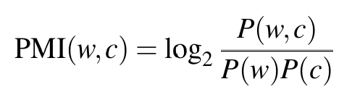
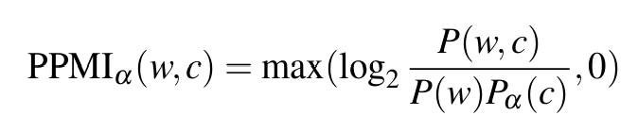
PMI

Slide 11

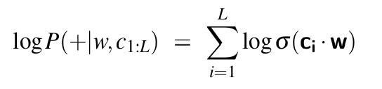

Word2vec
이진 분류기

Slide 12
Word2vec
skip gram embeddings
1. Treat the target word and a neighboring context word as positive examples.
2. Randomly sample other words in the lexicon to get negative samples.
3. Use logistic regression to train a classifier to distinguish those two cases.
4. Use the learned weights as the embeddings.

Slide 13
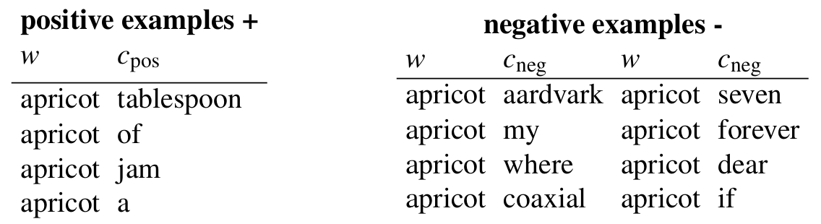
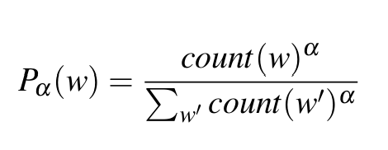
Word2vec

Slide 14
Word2vec
Maximize the similarity of the target word, context word pairs drawn from the positive examples
Minimize the similarity of the pairs from the negative examples.

Slide 15
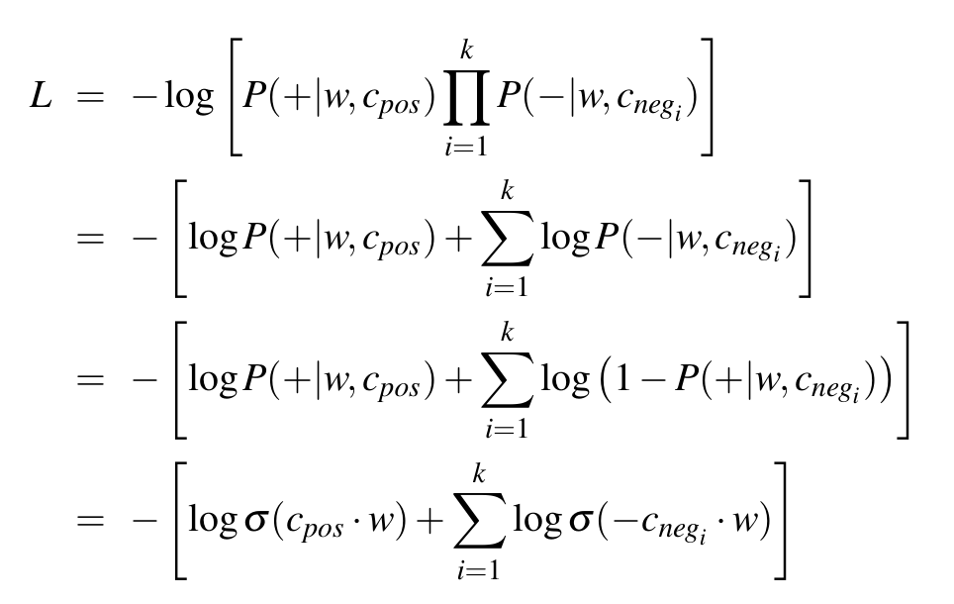
Word2vec
손실함수 L을 최소화 하는 것이 목표

Slide 16
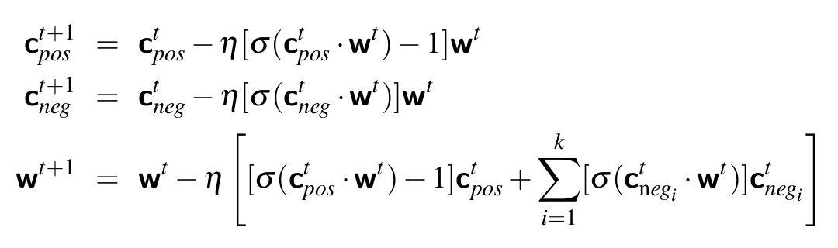
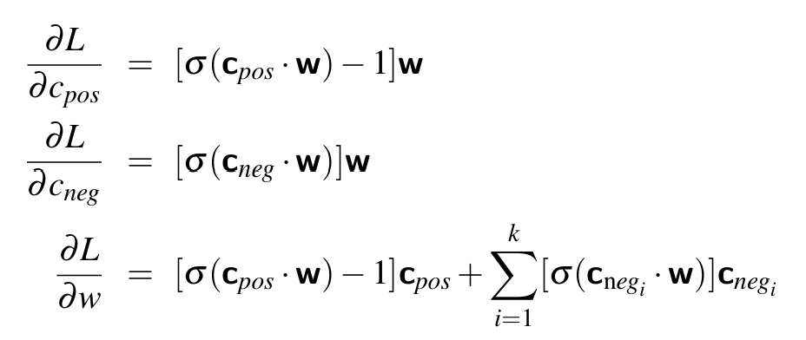
Word2vec
gradient descent

